Slide 1
ARTIFICIAL INTELLIGENCE (AI)
PRAKTIKUM 3
Dosen Pengampu : Renovita Edelani S.ST., M.Tr.Kom
oleh : Dukhaan Kamimpangan
2 D4 IT A
3122600003

Slide 2
TUGAS praktikum 1 bfs source code
graph = {
'A' : ['B','C'],
'B' : ['H'],
'C' : ['D','E'],
'D' : ['F','G'],
'E' : ['I'],
'F' : ['H'],
'G' : ['I'],
'H' : ['I'],
'I' : []
}
visited = [] # List for visited nodes.
queue = [] #Initialize a queue
def bfs(visited, graph, node): #function for BFS
visited.append(node)
queue.append(node)
while queue: # Creating loop to visit each node
m = queue.pop(0)
print (m, end = " ")
for neighbour in graph[m]:
if neighbour not in visited:
visited.append(neighbour)
queue.append(neighbour)
# Driver Code
print("Following is the Breadth-First Search")
bfs(visited, graph, 'A') # function calling

Slide 3
TUGAS praktikum 1 dFS source code
graph = {
'A' : ['B','C'],
'B' : ['H'],
'C' : ['D','E'],
'D' : ['F','G'],
'E' : ['I'],
'F' : ['H'],
'G' : ['I'],
'H' : ['I'],
'I' : []
}
visited = set() # Set to keep track of visited nodes of graph.
def dfs(visited, graph, node): #function for dfs
if node not in visited:
print (node)
visited.add(node)
for neighbour in graph[node]:
dfs(visited, graph, neighbour)
# Driver Code
print("Following is the Depth-First Search")
dfs(visited, graph, 'A')

Slide 4
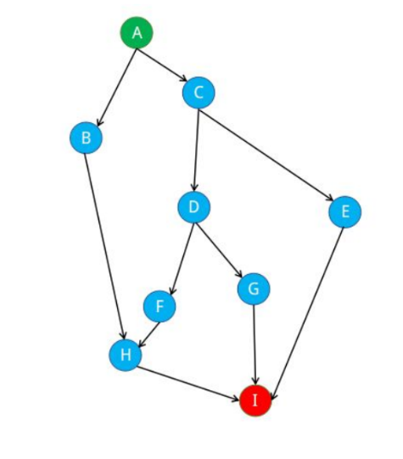
TUGAS praktikum 1 bfs Traversal
Pop | Queue
A | B | C
B | C | H
C | H | D | E
H | D | E | I
D | E | I | F | G
E | I | F | G
I | F | G
F | G
G

Slide 5
TUGAS praktikum 1 dfs Traversal
POP | QUEUE
A | B | C
B | H | C
H | I | C
I | C
C | D | E
D | F | G | E
F | G | E
G | E
E

Slide 6
TUGAS praktikum 2 bfs source code
graph = {
'1' : ['2','3'],
'2' : ['5','4'],
'3' : ['4','6'],
'4' : ['5','7','8','6'],
'5' : ['7'],
'6' : ['8','9'],
'7' : ['9'],
'8' : ['9'],
'9' : []
}
visited = [] # List for visited nodes.
queue = [] #Initialize a queue
def bfs(visited, graph, node): #function for BFS
visited.append(node)
queue.append(node)
while queue: # Creating loop to visit each node
m = queue.pop(0)
print (m, end = " ")
for neighbour in graph[m]:
if neighbour not in visited:
visited.append(neighbour)
queue.append(neighbour)
# Driver Code
print("Following is the Breadth-First Search")
bfs(visited, graph, '1') # function calling

Slide 7
TUGAS praktikum 2 dFS source code
graph = {
'1' : ['2','3'],
'2' : ['5','4'],
'3' : ['4','6'],
'4' : ['5','7','8','6'],
'5' : ['7'],
'6' : ['8','9'],
'7' : ['9'],
'8' : ['9'],
'9' : []
}
visited = set() # Set to keep track of visited nodes of graph.
def dfs(visited, graph, node): #function for dfs
if node not in visited:
print (node)
visited.add(node)
for neighbour in graph[node]:
dfs(visited, graph, neighbour)
# Driver Code
print("Following is the Depth-First Search")
dfs(visited, graph, '1')

Slide 8
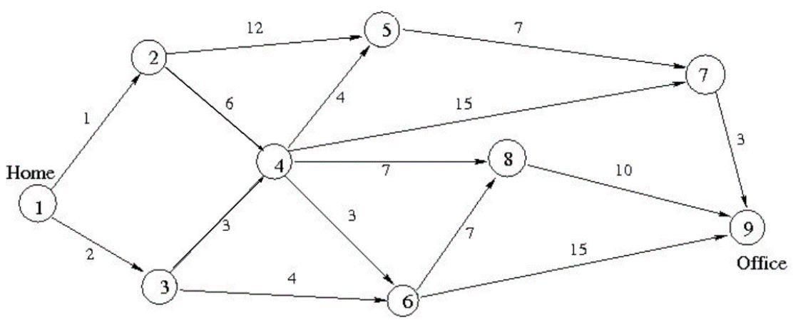
TUGAS praktikum 2 bfs Traversal
Pop | Queue
1 | 2 | 3
2 | 3 | 4 | 5
3 | 4 | 5 | 6
4 | 5 | 6 | 7
5 | 6 | 7 | 8
6 | 7 | 8 | 9
7 | 8 | 9
8 | 9
9

Slide 9

TUGAS praktikum 2 dfs Traversal
Pop | Queue
1 | 2 | 3
2 | 5 | 4 | 3
5 | 7 | 4 | 3
7 | 9 | 4 | 3
9 | 4 | 3
4 | 8 | 6 | 3
8 | 6 | 3
6 | 3
3

Slide 10
TUGAS praktikum 3 bfs source code
graph = {
'0' : ['3','4'],
'1' : ['0','6'],
'2' : ['5','6'],
'3' : ['1','7'],
'4' : ['6'],
'5' : ['6','7'],
'6' : ['4','2'],
'7' : ['5'],
}
visited = [] # List for visited nodes.
queue = [] #Initialize a queue
def bfs(visited, graph, node): #function for BFS
visited.append(node)
queue.append(node)
while queue: # Creating loop to visit each node
m = queue.pop(0)
print (m, end = " ")
for neighbour in graph[m]:
if neighbour not in visited:
visited.append(neighbour)
queue.append(neighbour)
# Driver Code
print("Following is the Breadth-First Search")
bfs(visited, graph, '0') # function calling

Slide 11
TUGAS praktikum 3 dFS source code
graph = {
'0' : ['3','4'],
'1' : ['0','6'],
'2' : ['5','6'],
'3' : ['1','7'],
'4' : ['6'],
'5' : ['6','7'],
'6' : ['4','2'],
'7' : ['5'],
}
visited = set() # Set to keep track of visited nodes of graph.
def dfs(visited, graph, node): #function for dfs
if node not in visited:
print (node)
visited.add(node)
for neighbour in graph[node]:
dfs(visited, graph, neighbour)
# Driver Code
print("Following is the Depth-First Search")
dfs(visited, graph, '0')

Slide 12
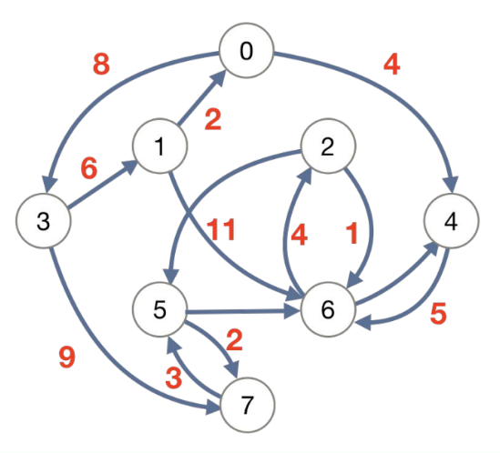
TUGAS praktikum 3 bfs Traversal
Pop | Queue
0 | 3 | 4
3 | 4 | 1 | 7
4 | 1 | 7 | 6
1 | 7 | 6
7 | 6 | 5
6 | 5 | 2
5 | 2
2

Slide 13
TUGAS praktikum 3 dfs Traversal
Pop | Queue
0 | 3 | 4
3 | 1 | 7 | 4
1 | 6 | 0 | 4
6 | 4 | 2
4 | 2 | 6
2 | 5 | 6
5 | 7
7

Slide 14
kesimpulan
1. Depth-First Search (DFS):
Prinsip: DFS mengunjungi node sejauh mungkin sebelum mundur dan melanjutkan ke node berikutnya.
Implementasi: Fungsi dfs menggunakan rekursi untuk mengunjungi node secara rekursif dan menambahkannya ke dalam set visited untuk menghindari pengulangan.
Urutan output: Output DFS adalah urutan node yang diunjungi, dimulai dari node awal 'A’.
2. Breadth-First Search (BFS):
Prinsip: BFS mengunjungi semua tetangga dari suatu node sebelum melanjutkan ke node tetangga selanjutnya.
Implementasi: Fungsi bfs menggunakan antrian (queue) untuk mengelola urutan node yang akan dikunjungi. Node yang dikunjungi ditambahkan ke dalam list visited.
Urutan output: Output BFS adalah urutan node yang diunjungi, dimulai dari node awal 'A’.
DFS dan BFS adalah dua metode pencarian pada graf. DFS menggunakan pendekatan rekursif dan mengeksplorasi sejauh mungkin sebelum kembali, sementara BFS mengeksplorasi secara lebih "lebar" dengan melihat semua tetangga sebelum memeriksa tetangga yang lebih jauh.
Keduanya digunakan dalam berbagai konteks seperti traversal graf, mencari jalur terpendek, dan sebagainya, tergantung pada kebutuhan aplikasi.
Output DFS dan BFS dapat bervariasi tergantung pada struktur graf.

Slide 15

Terimakasih

